Slide 1
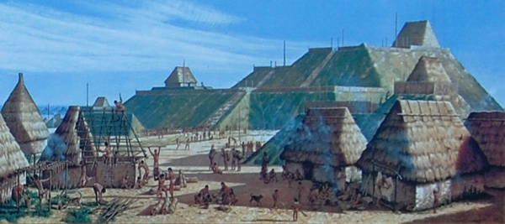
Native Americans

Slide 2
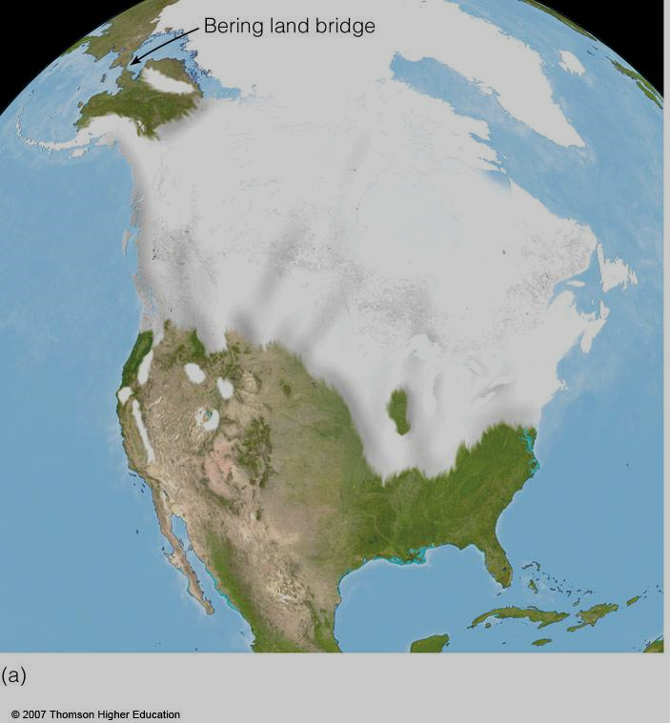
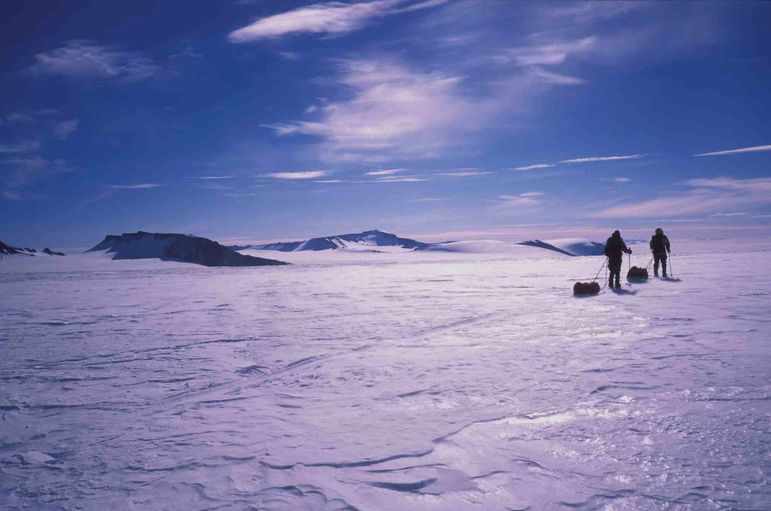
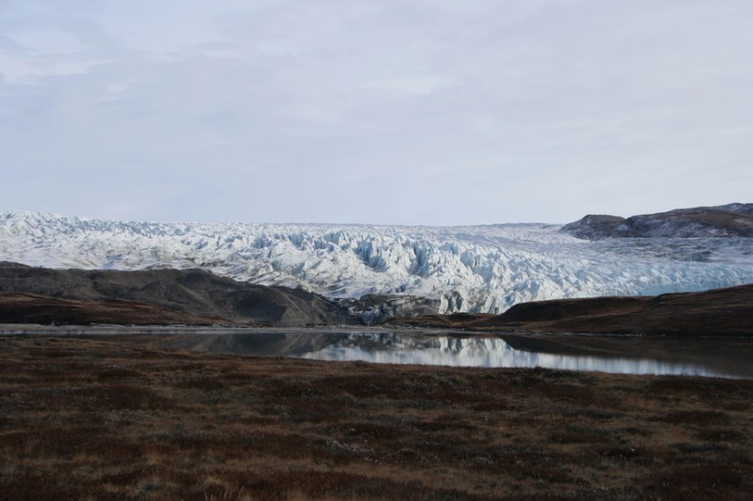
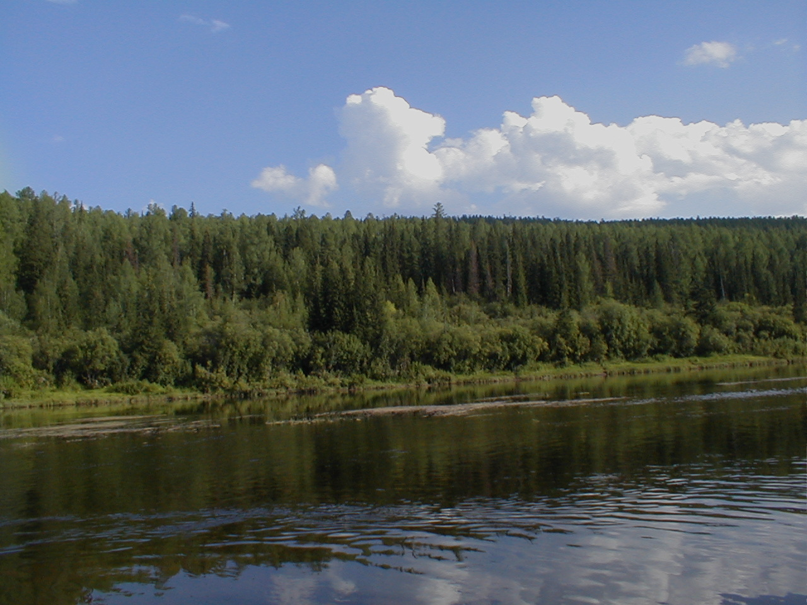
Ice Age 100,000-10,000 years ago
Notes:
2

Slide 3
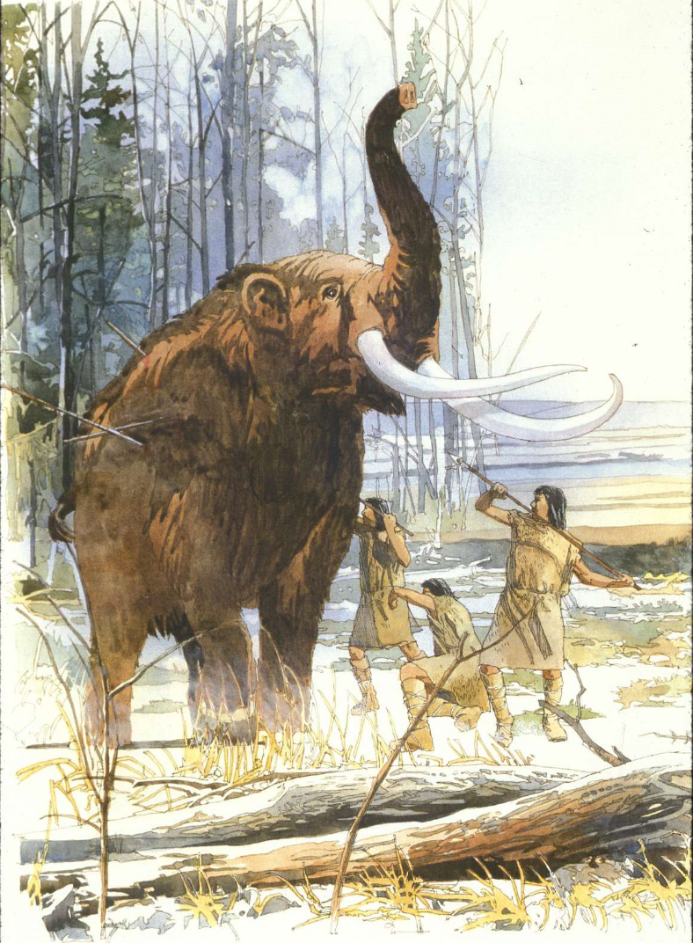
Beginning about 35,000* years ago nomadic hunters from Asia crossed “Beringia” from Siberia to North America, peopling the Western Hemisphere.

Slide 4
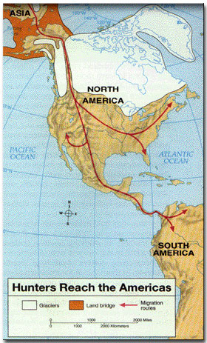
The sea level was much lower then with much of the ocean water packed into massive ice caps.
When the Ice Age ended, the melting ice caused the ocean level to rise, “trapping” these waves of traveling hunters.

Slide 5
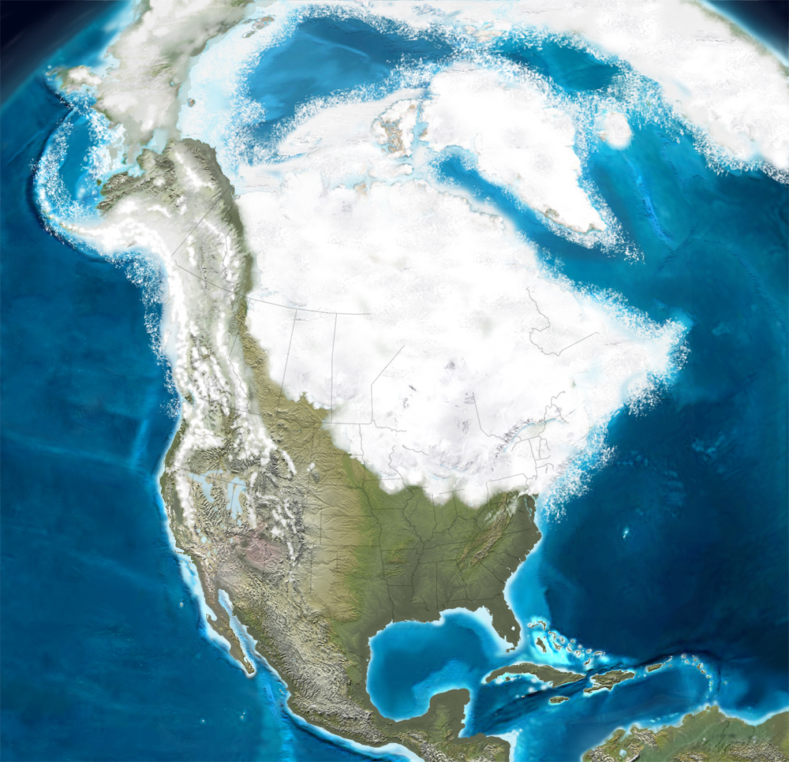
One theory suggests that some may have also migrated from Europe, around the same time.
Notes:
5

Slide 6
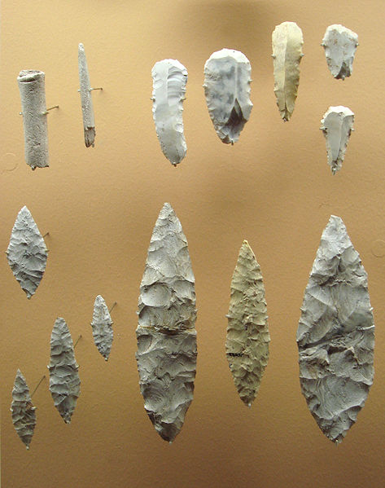
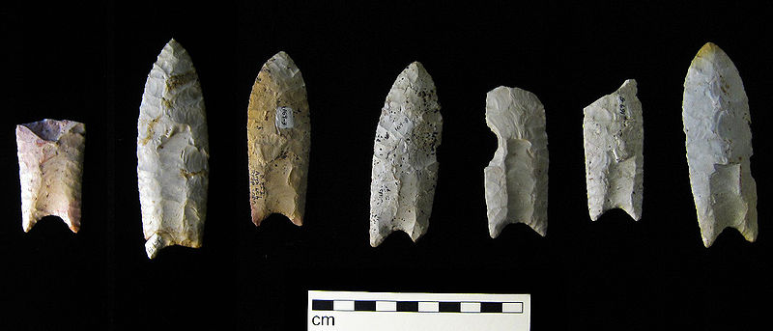
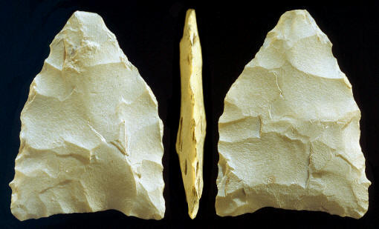
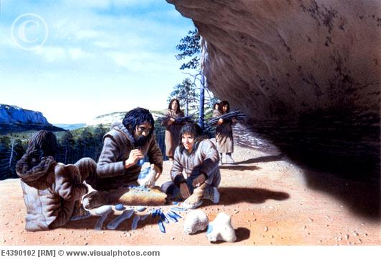
Notes:
6

Slide 7
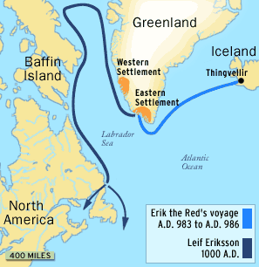
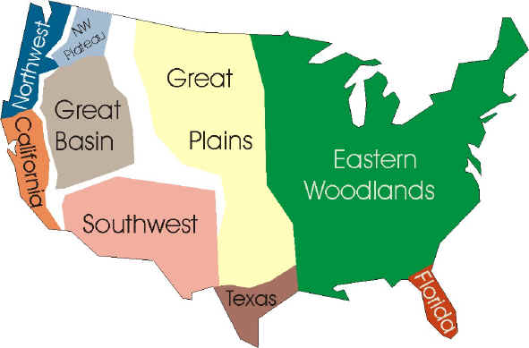
Native Americans were isolated from contact with the rest of the world until the Vikings came and Columbus.
Scientists estimate that when Columbus arrived in 1492, some 54 million people occupied North and South America.
These Native Americans evolved into thousands of different tribes speaking some 2,000 separate languages.

Slide 8
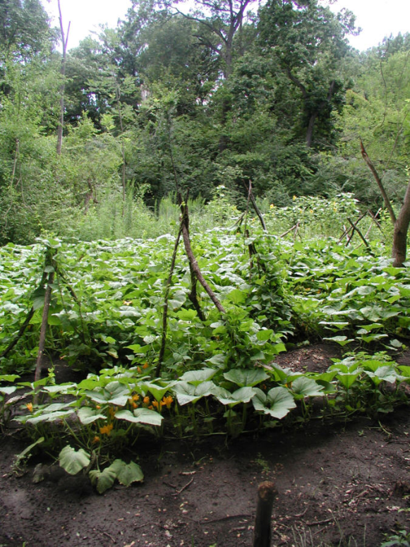
Corn (maize) : first cultivated in Mexico 6000 BC
Cultivation of corn spread to almost all areas of North and South America.
The 3 sisters: corn, beans, and squash.

Slide 9
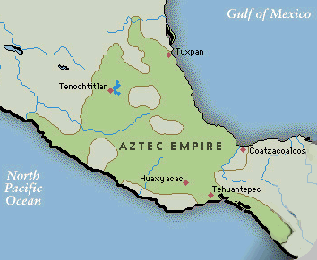
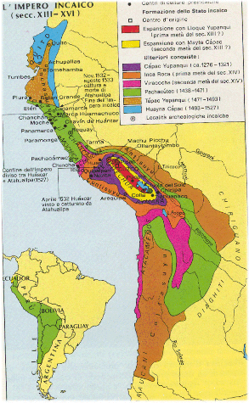
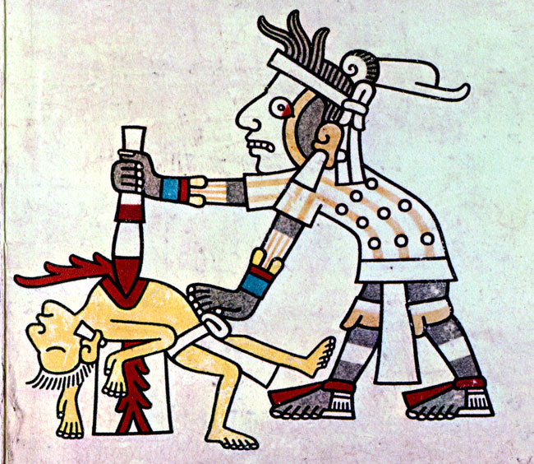
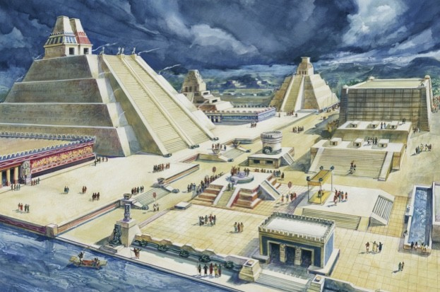
By 1492, the only real empires in the modern sense existing in the new world were the Aztec and Inca in central and South America. Sophisticated agriculture allowed for large populations and permanent cities
They also had advanced commerce, mathematics, and accurate astronomical observations.
They did not have advanced metal work, draft animals (besides the llama) or the wheel.

Slide 10
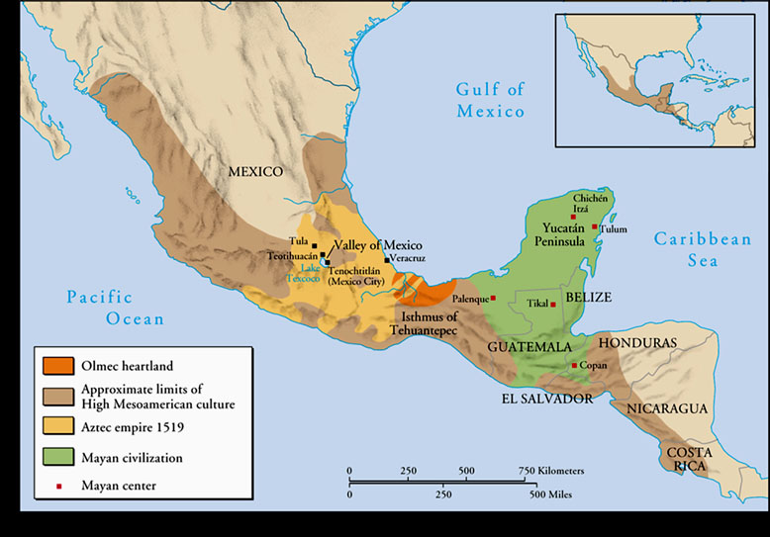
The Aztec

Slide 11
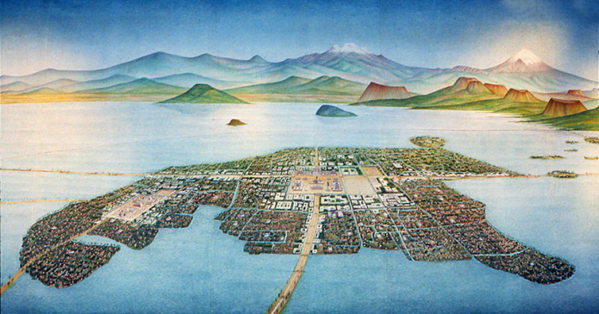
Capital:Tenochtitlan, built on an island in Lake Texcoco, which had 250,000 people by 1520.
Subjugated the people of central Mexico, and demanded tribute.
Brutally sacrificed people to appease the gods and keep the universe in order.

Slide 12
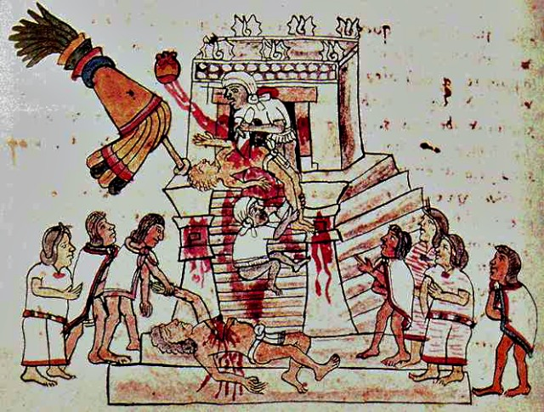

Slide 13
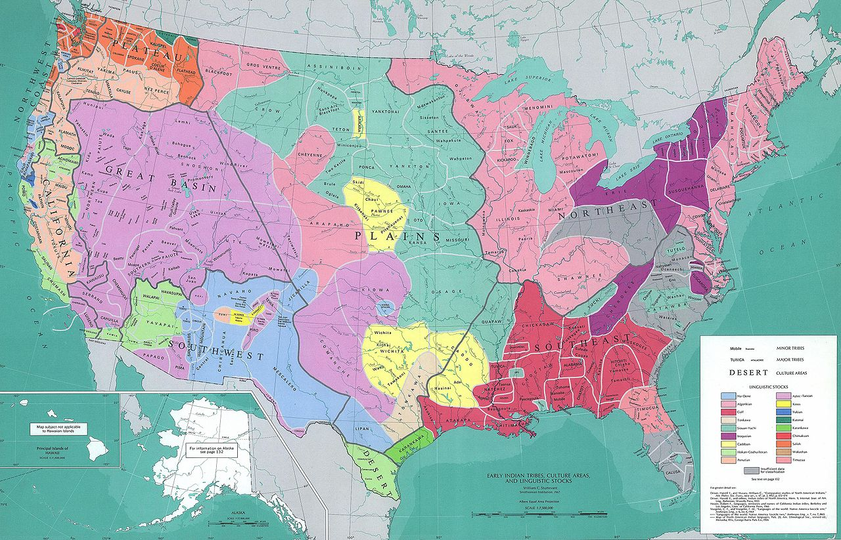
Native Americans in present-day US

Slide 14
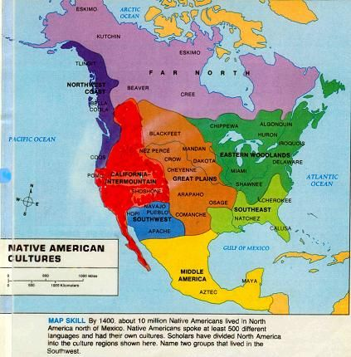
Great Plains
& Rockies
Pacific
Coast
Eastern
Woodlands
Southwest

Slide 15
Old Native Cultures
Anasazi
Built large settlements in the Southwest by 1000 AD
Settlements included Chaco Canyon and Mesa Verde
Probably ended due to overfarming and wasteful use of resources

Slide 16
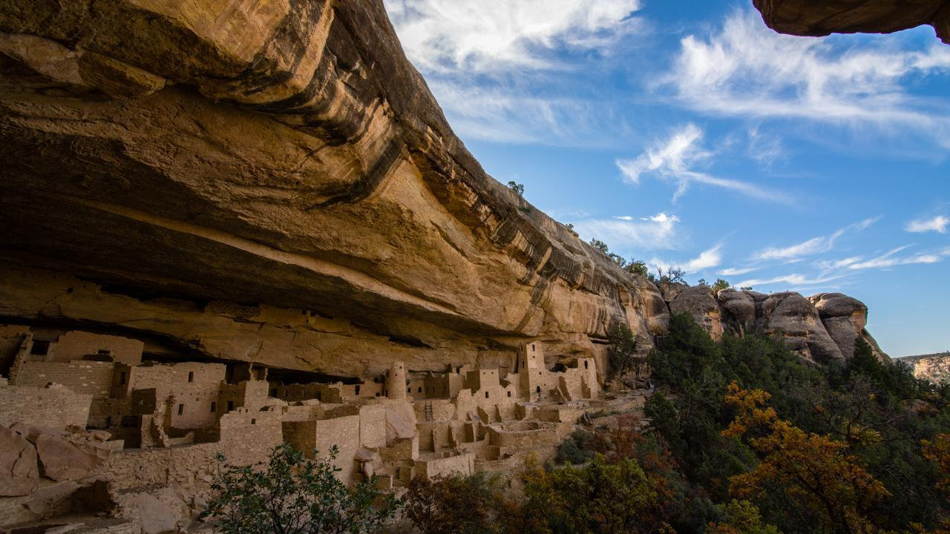

Slide 17
Old Native Cultures
Mississippian
Large civilization in the Midwest and Southeast by 1000 AD
Known as “mound builders”
Largest settlement was Cahokia
Probably ended due to extensive warfare

Slide 18
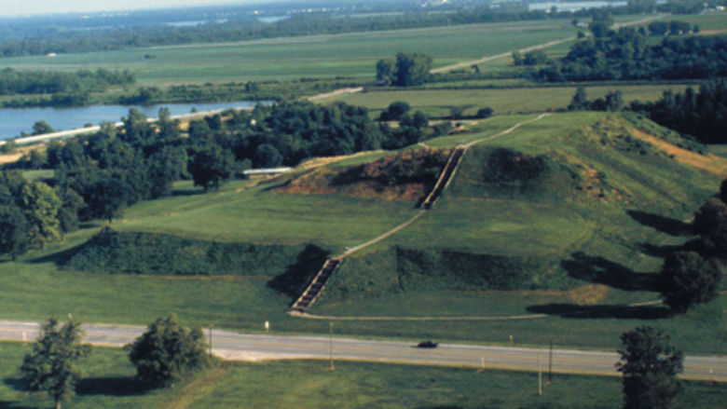

Slide 19
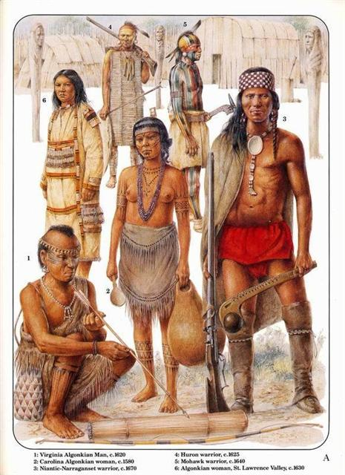
Eastern Woodlands
Small-scale agriculture, hunting, gathering, fishing
Many associated tribes and confederations
Often had matrilineal societies
Lived in forests, but burned them regularly for hunting purposes.
Powhatan, Iroquois, Abenaki, Algonquin, Creek,

Slide 20
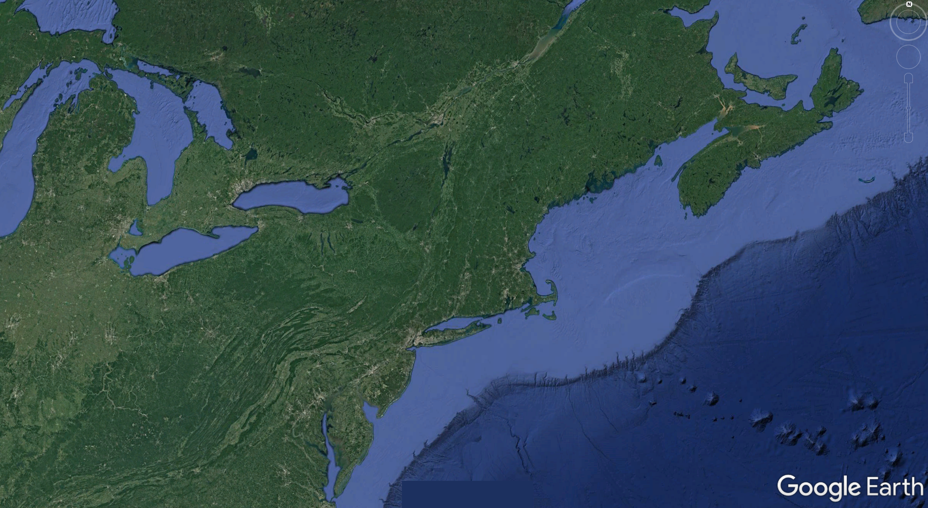
Huron/Wyandot
Algoquin & Montagnais
Maliseet
Mikmaq
Ottawa
Eastern Abenaki
Mississauga
Western Abenaki
Potawatomi
Iroquois
Mahican
Miami
Erie
Susquehanna
Various Tribes
Lenape
(Delaware)
Powhatan
Shawnee
Cherokee

Slide 21
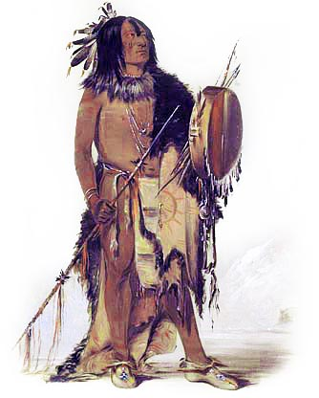
Great Plains and Rockies
Hunters and gathering societies, very limited agriculture (almost nomadic)
Bison were a main food source.
Major culture shift after the introduction of the horse
Several large tribes controlled large areas
Sioux (Lakota), Comanche, Shoshone, Kiowa, Osage

Slide 22
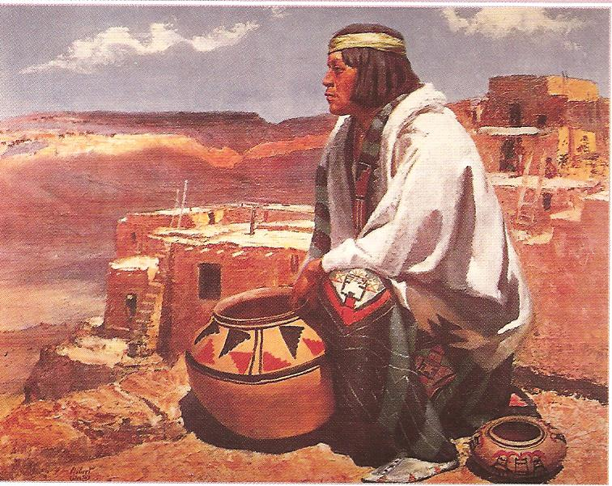
The Southwest
Large scale agriculture & irrigation
Large, adobe brick-built building and settlements
The Anasazi were among the first to irrigate and build settlements inside canyons
Several large tribes controlled large areas
Navajo, Hopi, Apache

Slide 23
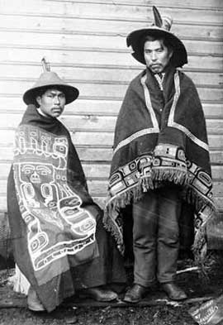
The Northwest
Hunting, gathering, and fishing
Many smaller-sized tribes
Strong warrior traditions among the more powerful tribes
Extensive use of cedar trees, for totem poles, canoes, long houses, even clothing
“Potlatch” ceremonies
Chinook, Tlingit, Makah, Yakima

Slide 24
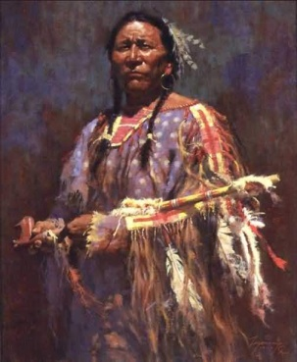
Native Americans had extensive trade networks across the continent
Most tribes were animist (spiritual power in the natural world) with extensive rituals
Very ceremonial and symbolic
Family and tribal bonds were very strong

